Slide 1
LIVE++: BEHIND THE SCENES OF ENGINE-AGNOSTIC C++ CODE HOT-RELOAD
THQN Dev Summit
May 11, 2023
Stefan Reinalter, MSc – Founder/CTO @ Molecular Matters GmbH https://molecular-matters.com

Slide 2
WHO AM I?
Stefan Reinalter Founder/CTO/wearer of many hats @ Molecular Matters
Started in the games industry in 2003 during Xbox/PS2 era
Founded Molecular Matters in 2011
Worked on my own engine and a real-time radiosity solution
Freelance work
Started teaching, blogging, writing for AltDevBlogADay
Contributed to Game Engine Gems 3

Slide 3
AGENDA
Overview
Technology
Deep dive
Live++ 2 for Unreal Engine
Outlook
Q & A

Slide 4
Overview

Slide 5
LIVE++ TIMELINE
First idea for Live++ in 2016
Started R&D
Continued working on it alongside other projects
First working prototype in 2017
Closed Beta in September 2017
Official launch March 27, 2018
Integrated into Unreal Engine 4.22 and featured at GDC 2019

Slide 6
GDC 2019 “STATE OF UNREAL” ANNOUNCEMENT

Slide 7
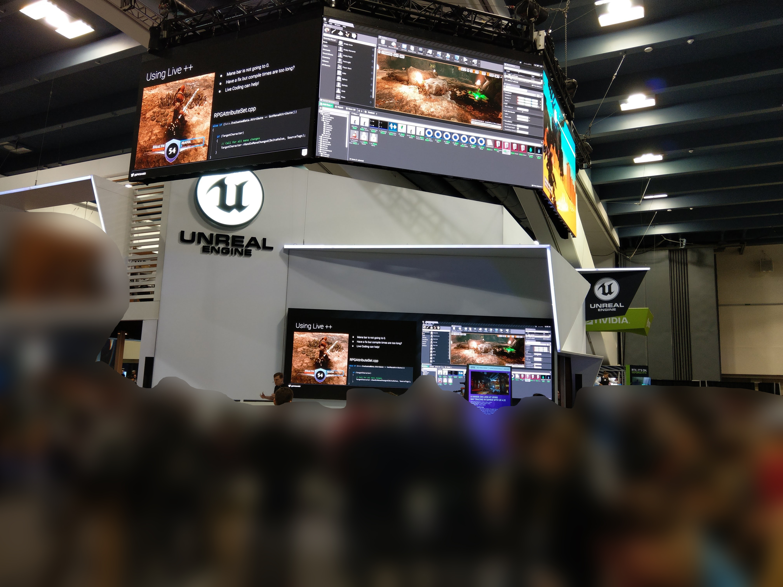
GDC 2019 UNREAL ENGINE BOOTH

Slide 8
LIVE++ STATS
>7 years of development
>60 non-UE companies in >20 countries
90% Game development studios
10% Other industries
Ships with Unreal Engine 4.22 and later
Free for all UE licensees!

Slide 9
LIVE++ GOALS
Trade “exit, compile, link, start, load” cycle against “compile”
Modify existing code and data, add new code and data
Native performance (no interpreter or JIT compilation)
Project-setup agnostic (.exe, .dll, .lib, makefiles, …)
Application-agnostic (hot-reload everything you have the source for)
Generic, i.e. must work on existing code without modifications
External process (as little change to memory footprint as possible)

Slide 10
LIVE++ HIGH-LEVEL OVERVIEW
Challenges
How to find build dependencies (.cpp & .h #includes)?
How to compile changes using the original compiler options?
How to link against existing code and data?
New code and data must be loaded into target process
How to support debugging?
How to redirect functions?

Slide 11
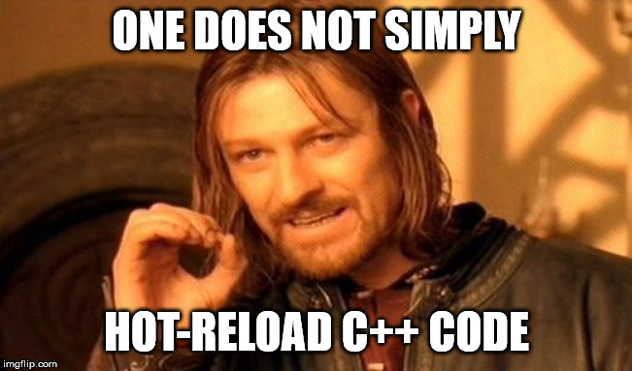
LIVE++ HIGH-LEVEL OVERVIEW

Slide 12
LIVE++ HIGH-LEVEL OVERVIEW
4 main pillars
Compiling changed code
Loading compiled code
Patching relocations
Patching functions
➔ Hooks, Hot-Restart, Hot-Deoptimize, Hot-Fix build upon this

Slide 13
Technology
Stage 1: Compiling changed code

Slide 14
COMPILING CHANGED CODE: WHICH FILES ARE PART OF A BUILD?
Dependency tree extracted from PDB
Data is there, but not ready-made
Relative paths vs. absolute paths
Paths relative to different (working) directories
Remote paths (distributed compilation)
Some .obj pulled in from .lib
Some .obj moved/renamed before being linked
No distinction between compiler source (e.g. CRT) and user source

Slide 15
COMPILING CHANGED CODE: WHICH FILES ARE PART OF A BUILD?
Must use original toolchain (if available)
Some projects mix compilers due to 3rd-party libraries
Must use original command-line options
Toolchain and options extracted from PDB
Toolchain may point to remote location (e.g. FASTBuild, Incredibuild)
Use local fallback
Allow overriding toolchain directory

Slide 16
COMPILING CHANGED CODE: WHICH FILES ARE PART OF A BUILD?
➔ Result
1:N mapping of files that need to be recompiled
Set of files which are part of a library
Set of files which are unity/blob files that can be split
Set of used static libraries
Toolchain and compiler options used by each translation unit

Slide 17
COMPILING CHANGED CODE
Command-line compilation (e.g. spawn cl.exe)
Might need additional environment setup
vcvars*.bat in Visual Studio, very slow!

Slide 18
COMPILING CHANGED CODE
➔ Solution: Spawn vcvars*.bat process once, grab environment, cache
Once for each toolchain executable
Fetching the environment of a foreign process is… adventurous

Slide 19
COMPILING CHANGED CODE
Concurrent compilation
Some command-line options are incompatible with each other
E.g. writing to the same PDB concurrently
/ZI vs. /Z7 debug information format
Precompiled headers
➔ Cannot just blindly spawn compiler process for each file

Slide 20
COMPILING CHANGED CODE
Results of this stage
Bunch of recompiled .objs
Contain existing symbols (data & functions)
Can contain new symbols (data & functions)
Refer to external symbols via relocations

Slide 21
Technology
Stage 2: Loading compiled code

Slide 22
LOADING CODE FROM .OBJ FILES
Naïve idea
Allocate virtual memory in target process
Map code and data sections from .obj files
Initialize/construct global and static data symbols
Code without relocations can live anywhere
int AnswerToEverything()
{
return 42;
}
AnswerToEverything: mov eax,2Ah
ret

Slide 23
LOADING CODE FROM .OBJ FILES
But 99% of code has relocations to code and data symbols
static void Indirection()
{
printf("Indirection");
}
void Func(void)
{
printf("Func");
Indirection();
}
Func: sub rsp,28h
lea rcx, [string “Func"]
call printf
call Indirection
add rsp,28h
ret

Slide 24
LOADING CODE FROM .OBJ FILES
SECTION HEADER #4
.text$mn name [flags omitted]
RAW DATA #4
00000000: 48 83 EC 28 48 8D 0D 00 00 00 00 E8 00 00 00 00
00000010: E8 00 00 00 00 48 83 C4 28 C3
RELOCATIONS #4
Symbol Symbol
Offset Type Index Name
-------- ------ -------- ------
00000007 REL32 44 ??_C@_0P@HLIOGJKC@Func@ (`string')
0000000C REL32 1F printf
00000011 REL32 20 ?Indirection@@YAXXZ (void __cdecl Indirection(void))
E8: CALL – Call Procedure

Slide 25
LOADING CODE FROM .OBJ FILES
Relocations are usually resolved by the linker
But we need to relocate to existing symbols
Globals, statics, pointers to data, etc. need to retain their value
memcpy’ing from old to new instances is not an option
What about debugging?
How does the debugger know about new symbols?
How can we step through new code?

Slide 26
LOADING CODE FROM .OBJ FILES: DEBUGGING SYMBOLS
When does a debugger load symbols?
Spawning or attaching to a process (.exe)
Loads symbols from PDBs for all modules loaded into process
Typical debugger main loop then waits for events
E.g. LOAD_DLL_DEBUG_INFO sent by the OS when loading a .dll

Slide 27
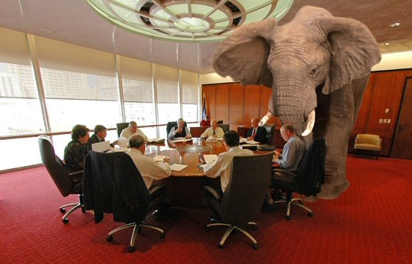
LOADING CODE FROM .OBJ FILES: DEBUGGING SYMBOLS
Credit: tomstuart.org

Slide 28
LOADING CODE FROM .OBJ FILES: DEBUGGING SYMBOLS
The elephant in the room: we don’t have a .dll
So let’s generate one!
Disclaimer: we abuse .dlls as a container for code and data
There are no exported symbols, no entry point
.dlls were never intended to be used this way!

Slide 29
LOADING CODE FROM .OBJ FILES: DEBUGGING SYMBOLS
Use linker to generate fake .dll and .pdb
Code and data in .obj have unresolved relocations
Cannot resolve those at link time, need to relocate to existing symbols
➔ Throw away stuff in the .obj that we don’t need
E.g. linker directives, existing symbols
➔ “Massage” .obj files, lie to the linker
Mark relocations as being resolved, link manually later
Must keep corresponding debug info in .pdb intact, which is tricky

Slide 30
LOADING CODE FROM .OBJ FILES: DEBUGGING SYMBOLS
Result: Fake .dll alongside .pdb, but:
.dll cannot run, relocations missing
Cannot relocate to existing symbols until .dll is loaded
LoadLibrary() loads .dll into the address space, anywhere
But relocations are 32-bit, problematic for 64-bit processes
Vast address space, but 32-bit relocations can only reach ±2GB
Calls entry point
Calls dynamic initializers (constructors for global/static symbols)
➔ Will crash in our case

Slide 31
LOADING CODE FROM .OBJ FILES: DEBUGGING SYMBOLS
➔ Solution, part 1
Find suitable spot for .dll in target process’ address space
VirtualQueryEx()
Modify .dll header to make it load at preferred address
Disable “Dynamic Base”/ASLR
Manually rebase .dll image too
Modify .dll image on disk to disable entry point

Slide 32
LOADING CODE FROM .OBJ FILES: DEBUGGING SYMBOLS
➔ Solution, part 2
Call LoadLibrary()
Disable dynamic initializers in loaded code
Patch unresolved relocations
Restore entry point in memory
Restore entry point on disk (needed for multi-process editing!)
Manually call entry point
Done! New code and data loaded with debugging symbols
Automatically supports adding new globals, statics, data, …

Slide 33
Technology
Stage 3: Patching relocations

Slide 34
PATCHING RELOCATIONS
The devil is in the details
Cannot just blindly patch all relocations
Need to have understanding of what the compiler and OS do (anonymous namespaces, control-flow guard, buffer security checks, exceptions, RTTI, virtual functions, globals, statics, dynamic initializers, thread-local storage, …)
Need to have understanding of what happens at the assembly level (function statics, “magic” statics)

Slide 35
PATCHING RELOCATIONS
Lots of special cases due to C++ features
Massive explosion of complexity when patching relocations
At this point, Live++ has its own “context-aware” linker
Knows which relocations must be patched in which context
Knows which relocations must not be patched
How do we even get the addresses of symbols?
99% of relocations refer to existing symbols in our context

Slide 36
PATCHING RELOCATIONS: SYMBOL DATABASE
Symbols and type information contained in PDB
Public symbols (external linkage) exported using decorated name
Private symbols (internal linkage) exported using plain name
Problematic due to globals, statics, “magic” statics, TLS
Only option: must use decorated names for all symbols
But only .obj files hold full name information
Some symbols completely missing from PDB

Slide 37
PATCHING RELOCATIONS: SYMBOL DATABASE
Example
struct Clazz
{
Clazz() { printf("hello"); }
};
void Func()
{
// magic static. // needs to retain its state when patching Func().
static Clazz clazz; }

Slide 38
PATCHING RELOCATIONS: SYMBOL DATABASE
Func() in Visual Studio Debugger:
sub rsp,28h
mov rax,qword ptr gs:[58h]
mov ecx,dword ptr [_tls_index (07FFA9F73F628h)]
mov edx,0Ch
mov rcx,qword ptr [rax+rcx*8]
mov eax,dword ptr [rdx+rcx]
cmp dword ptr [g_externDataB+4h (07FFA9F73F594h)],eax
jg SimpleFunction+2Ch (07FFA9F734B1Ch)
add rsp,28h
ret
lea rcx,[g_externDataB+4h (07FFA9F73F594h)]
call _Init_thread_header (07FFA9F736338h)
cmp dword ptr [g_externDataB+4h (07FFA9F73F594h)],0FFFFFFFFh
jne SimpleFunction+27h (07FFA9F734B17h)
lea rcx,[string "hello" (07FFA9F73ABF4h)]
call printf (07FFA9F731530h)
lea rcx,[g_externDataB+4h (07FFA9F73F594h)]
call _Init_thread_footer (07FFA9F7362D0h)
add rsp,28h
ret
CRT symbols Unknown symbols?

Slide 39
PATCHING RELOCATIONS: SYMBOL DATABASE
Not even the debugger, but only the .obj knows the truth
RELOCATIONS #4
Symbol Symbol
Offset Type Index Name
-------- ------ -------- ------
0000000F REL32 33 _tls_index
00000014 SECREL 29 _Init_thread_epoch
00000021 REL32 32 ?$TSS0@?1??Func@@YAXXZ@4HA
0000002F REL32 32 ?$TSS0@?1??Func@@YAXXZ@4HA
00000034 REL32 14 _Init_thread_header
0000003A REL32_1 32 ?$TSS0@?1??Func@@YAXXZ@4HA
00000044 REL32 2F ??_C@_05CJBACGMB@hello@ (`string')
00000049 REL32 1A printf
00000050 REL32 32 ?$TSS0@?1??Func@@YAXXZ@4HA
00000055 REL32 15 _Init_thread_footer

Slide 40
PATCHING RELOCATIONS: SYMBOL DATABASE
Approach used by Live++
Load public symbols from PDB
Find incremental linking thunks in PDB (optional)
Find image sections and their sizes
Find .exe/.dll contributions
Reconstruct all other symbols by reading and analyzing .exe and .objs
Done lazily for recompiled files

Slide 41
PATCHING RELOCATIONS: SYMBOL DATABASE
Reconstruction challenges, part 1
There is no mapping from .obj symbol to PDB symbol
We don’t know where code from .obj was linked into .exe
Inlining, COMDATs, different compiler options for same function
CRT sections for dynamic initializers
➔ Easily one of the most complex parts in Live++

Slide 42
PATCHING RELOCATIONS: SYMBOL DATABASE
Reconstruction challenges, part 2
Microsoft DIA SDK is slow
Lots of trial and error making it scale to AAA projects
Slow path: minutes
Fast path: seconds, but still way too slow for my taste
➔ Live++ 2 uses its own PDB reader
https://github.com/MolecularMatters/raw_pdb (BSD-2)
Order of magnitude faster than DIA and LLVM

Slide 43
Technology
Stage 4: Patching functions

Slide 44
PATCHING FUNCTIONS
Naïve approach
Redirect calls of old functions to new functions
Doesn’t work for code not controlled by us
E.g. 3rd-party applications loading our code (e.g. Maya plug-ins)
Can’t find call locations in foreign application
Hard to find and patch data, e.g. pointers to functions

Slide 45
PATCHING FUNCTIONS
Better approach
All roads lead to Rome!
Function calls
Pointers to functions
Calls through virtual function tables
Patch existing functions directly
Redirect them to the new function from within
Automatically handles problematic cases
Existing function
Recompiled function

Slide 46
PATCHING FUNCTIONS
3 alternatives used by Live++
Patch incremental linking thunks (MSVC on Windows only)
Direct jump to new function
Function needs to be at least 5 bytes long
Indirect jump to direct jump to new function
Uses linker’s /FUNCTIONPADMIN support
Function needs to be at least 2 bytes long

Slide 47
PATCHING FUNCTIONS
Patch incremental linking thunks
Thunk addresses gathered from PDB
Overwrite thunk with relative jump to new function
E9: JMP - Jump
_msize_dbg:
E9 96 11 09 00 jmp _msize_dbg
charNode::length:
E9 A1 60 04 00 jmp charNode::length
_lseeki64:
E9 9E C2 0C 00 jmp _lseeki64
__vcrt_freeptd:
E9 99 EF 02 00 jmp __vcrt_freeptd

Slide 48
PATCHING FUNCTIONS
Direct jump to new function
Relative jump needs 5 bytes (E9 00 00 00 00)
Need to ensure no thread’s instruction pointer is in first 5 bytes
Otherwise would garble instruction stream read by CPU
Reading foreign process’ threads needs undocumented magic
E9: JMP - Jump

Slide 49
PATCHING FUNCTIONS
Indirect jump to direct jump to new function
Fallback for functions smaller than 5 bytes
Install relative jump to new function in front of original function
Redirect original function to relative jump in front
Relative short jump only needs 2 bytes (EB 00)
EB: JMP - Jump
00007FFA9C6B4AEB E9 20 C5 01 80 jmp Func (07FFA1C6D1010h)
Func: // original entry point of Func
00007FFA9C6B4AF0 EB F9 jmp 07FFA9C6B4AEBh

Slide 50
PATCHING FUNCTIONS
Target process is still running
Need to suspend and resume process at some point
Done out-of-process by Live++ Bridge
Bridge runs on same machine as Agent
Broker runs on any machine in LAN
Required for networked hot-reload
LAN
Dev PC
User application
Live++ Agent (.dll)
Live++ Bridge
Live++ Broker
TCP/IP
IPC

Slide 51
Live++ 2 for Unreal Engine

Slide 52
VANILLA LIVE++ 2 BENEFITS
Not tied to Unreal Engine updates
Live++ 2 launched on August 16, 2022 – still not available in UE
Live++ 2 probably won’t be integrated into UE4, only UE5
Faster iteration times
UBT has significant overhead
Customers have reported 6-7s UBT vs. 2-3s Live++ recompile times
Fastest access to new features and bug fixes

Slide 53
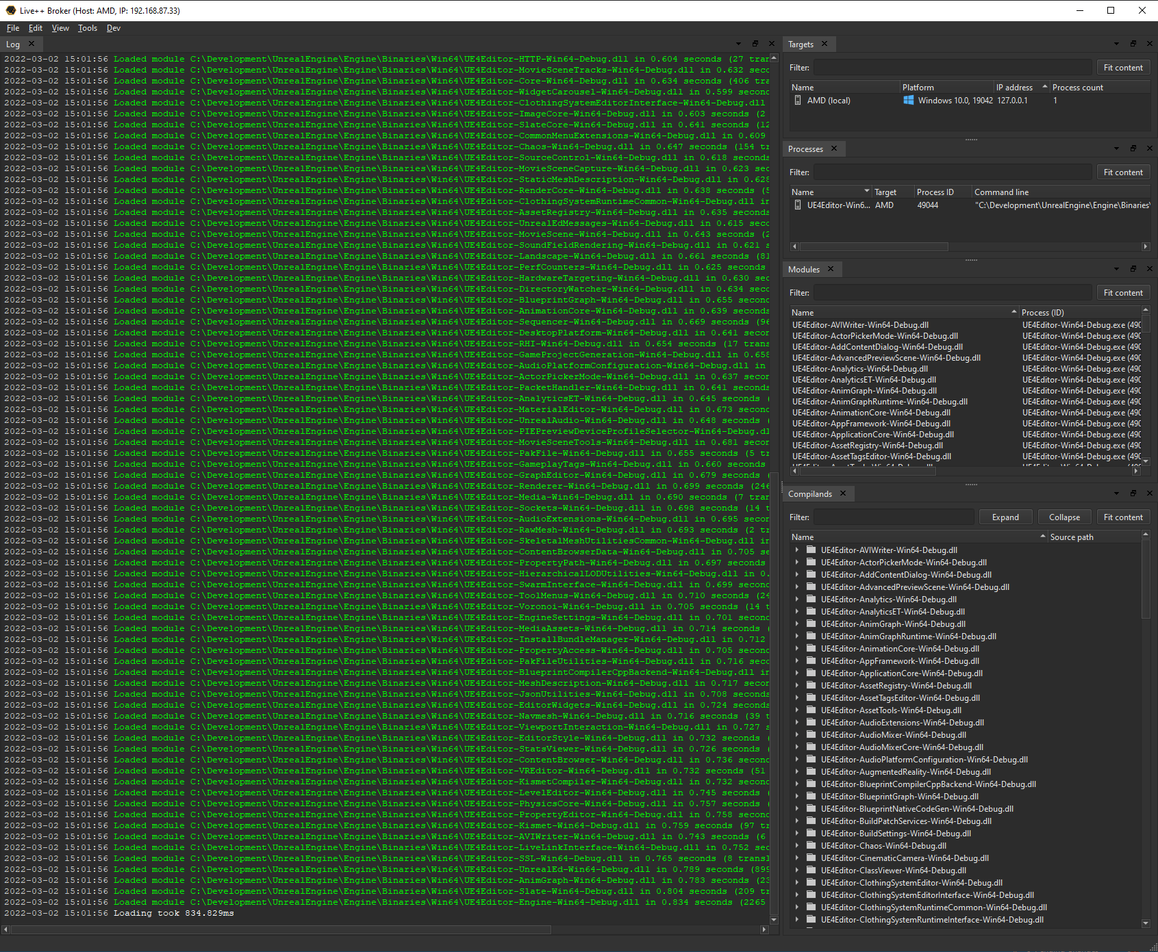
NEW IN LIVE++ 2
Greatly reduced loading times, scaling across available cores
Reduced Hot-Reload overhead

Slide 54
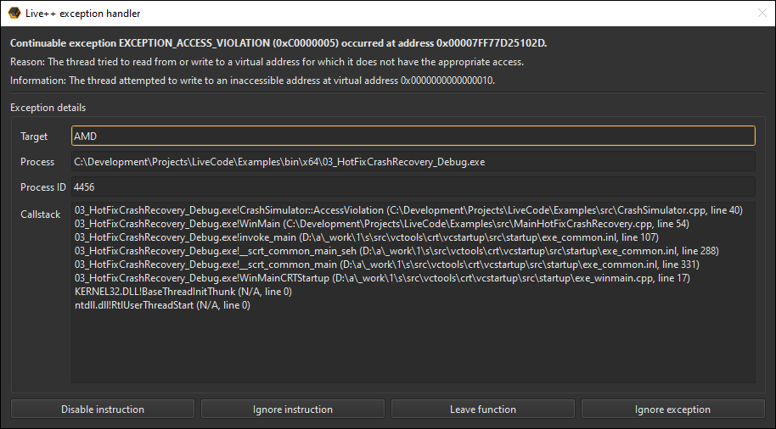
NEW IN LIVE++ 2
Improved Hot-Restart and Hot-Fix

Slide 55
NEW IN LIVE++ 2
Networked multi-process editing

Slide 56
NEW IN LIVE++ 2
Completely new UI
Hot-Deoptimize
Shortcut in Visual Studio, toggle state for current file
Queue for deoptimization
Reoptimize all at once
Filter in UI

Slide 57
Outlook

Slide 58
LIVE++: THE FUTURE
Support for consoles
Support for other platforms (?)
Support for other languages (?)
New ideas brewing…

Slide 59
WORLD PREMIERE – LIVE++ 2 ON XBOX SERIES X
Easy integration
Same as on Windows
No extra steps required
https://www.youtube.com/watch?v=rU_IMya4Ksc

Slide 60
THANK
YOU!
MolecularMatters
@molecularmusing @liveplusplus
Stefan Reinalter
https://molecular-matters.com

Slide 61
Bonus slides
Other approaches

Slide 62
C++ HOT-RELOAD APPROACHES
DLLs
Runtime-compiled C++ (RCC++, Molecule Engine)
C++ interpreter (Cling, CINT)
Native toolchain & binary patching (Live++)

Slide 63
C++ HOT-RELOAD APPROACHES: DYNAMIC LINK LIBRARIES
Advantages
Supported by almost all OSs
Trivial to load and unload code on-the-fly
Native code, native speed
Disadvantages
Need to be planned for from the start
Very hard to retrofit

Slide 64
C++ HOT-RELOAD APPROACHES: RUNTIME-COMPILED C++
Advantages
Can be made to work on all platforms
Native code, native speed
Disadvantages
Has to be integrated tightly into your own code
Hard to retrofit

Slide 65
C++ HOT-RELOAD APPROACHES: C++ INTERPRETER
Advantages
Supports almost all OSs
Disadvantages
Performance
Hard to support compiler-specific features
Debugging

Slide 66
C++ HOT-RELOAD APPROACHES: NATIVE TOOLCHAIN & BINARY PATCHING
Advantages
Native code, native speed
Supports all platform- and compiler-specific features
No code changes required
Disadvantages
Very complicated to get right
Very costly to support different OSs and different compilers

Slide 67
Bonus slides
Technology

Slide 68
COMPILING CHANGED CODE: WATCHING FOR MODIFIED FILES
Repeatedly check last modification timestamp
Not a CPU-friendly approach
Does not scale to AAA projects
Native filesystem watcher
ReadDirectoryChangesW() on Windows
Comes with its own set of problems
Mix of hierarchical FindFirstFile() and internal NtQueryDirectoryFile()
Used by Live++

Slide 69
LOADING CODE FROM .OBJ FILES: DEBUGGING SYMBOLS
New problem caused by having to load .dlls
Cannot load a .dll into a process that is held in the debugger
Debugger waits for OS kernel event, no way to “break” the loop
All user threads idle
Intricate problem to solve
➔ Two approaches used by Live++
Visual Studio debugger remote automation using COM
Jump-to-self code cave for all non-Live++ threads

