Slide 1



SUPERCHARGE YOUR WORKFLOW
USING LIVE++
Mojang Stockholm
October 23, 2025
Stefan Reinalter, MSc – Founder/CTO @ Molecular Matters GmbH
https://liveplusplus.tech

Slide 2
INTRODUCTION
Stefan Reinalter
Founder/CTO/wearer of many hats @ Molecular Matters
Started in the games industry in 2003 during Xbox/PS2 era
Founded Molecular Matters in 2011
  Worked on my own engine and a real-time radiosity solution
  Freelance work
  Started teaching, blogging, writing for AltDevBlogADay
  Contributed to Game Engine Gems 3

Slide 3
WHY CREATE LIVE++?
Spent many hours waiting for compiler & linker during Xbox/PS/Wii era
  Change a single line, compile (~3s), link (up to 1m)
  Start debugger on console target (~10s)
  Go to previous game state (>1m)
Introduced runtime-compiled C++ code in Molecule Engine in 2013
  Replaced scripting, code was written with this in mind from Day 1
  Used in “The Lion’s Song” (Windows, macOS, Switch, Android, iOS)
Live++ is the answer to this, but completely generic and standalone
Notes:
Runtime-Compiled C++ code as a scripting language in the Molecule Engine:
https://blog.molecular-matters.com/2013/08/27/using-runtime-compiled-c-code-as-a-scripting-language/

Slide 4
Overview

Slide 5
LIVE++ OVERVIEW
Launched March 2018
Generic, works on any kind of C & C++ code without modifications
IDE agnostic (Visual Studio, VS Code, CLion, Rider, Sublime Text, ...)
Project setup agnostic (.exe, .dll, .lib, makefiles, ...)
Toolchain and build system agnostic (MSVC, clang, lld, CMake, ninja, ...)
Multi-process editing (e.g. client & server, multiple platforms)
Networked editing (e.g. multiplayer games)
Supports Windows, Xbox One, Xbox Series X|S, PlayStation 4 & 5

Slide 6
LIVE++ CUSTOMERS/GAMES
Activision (Call of Duty) - Avalanche Studios - Bethesda (Fallout, Starfield)
Blizzard (World of Warcraft, Diablo IV) - Creative Assembly (Total War)
Electronic Arts (Battlefield 6, Skate, ...)
Guerrilla Games (Horizon Zero Dawn, Horizon Forbidden West, ...)
Haven Studios - Hello Games (No Man’s Sky) - id Software (Doom, ...)
IO Interactive - Larian Studios (Baldur's Gate 3)
MachineGames (Indiana Jones and the Great Circle) - Playground Games (Fable)
Remedy (Control, Alan Wake 2) - Riot Games (League of Legends) – Supercell
Techland (Dying Light) - Turn 10 Studios (Forza)
Ubisoft (Assassin's Creed, ...) - Warhorse Studios (Kingdom Come: Deliverance II)
Valve - Epic Games (Fortnite, Unreal Engine 4 & 5) – and many others...

Slide 7
LIVE++ VS. DISTRIBUTED BUILDS
Distributed build systems (Incredibuild, FASTBuild, SN-DBS, ...)
  Great improvement for full builds
    Can massively cut down compile times
  But linking still serial
    No improvement for small changes and iterative/incremental builds
Live++ does not compete with these systems
Live++ complements these systems

Slide 8
Use cases

Slide 9
HOT-RELOAD: FEATURE ITERATION
Usual feature iteration
  1) Start application, load state (e.g. scene, saved game, etc.)
  2) Test gameplay, rendering, run tests, etc.
  3) Close application
  4) Make changes, add code/tests, compile
  5) Link
Repeat all steps
  Even worse for multi-process or networked setups

Slide 10
HOT-RELOAD: FEATURE ITERATION
Feature iteration with hot-reload
  1) Start application, load state (e.g. scene, saved game, etc.)
  2) Test gameplay, rendering, run tests, etc.
  3) Close application
  4) Make changes, add code/tests, compile
  5) Link
Repeat step 2 & step 4 only
  Massive time saver, even more for multi-process or networked apps
  Live demo!

Slide 11
HOT-RESTART
Additional bonus with Hot-Restart
  Make changes to startup/initialization code
  Hot-Reload
  Hot-Restart without linking
    Patched code injected during Live++ startup
    Live demo!

Slide 12
HOT-RELOAD: OPTIMIZATION
Typical optimization loop
  1) Start application, load state (e.g. scene, saved game, etc.)
  2) Profile
  3) Close application
  4) Make changes, test hypotheses, compile
  5) Link
Repeat all steps

Slide 13
HOT-RELOAD: OPTIMIZATION
Optimization loop with hot-reload
  1) Start application, load state (e.g. scene, saved game, etc.)
  2) Profile
  3) Close application
  4) Make changes, test hypotheses, compile
  5) Link
Repeat step 2 & step 4 only
  Live demo!

Slide 14
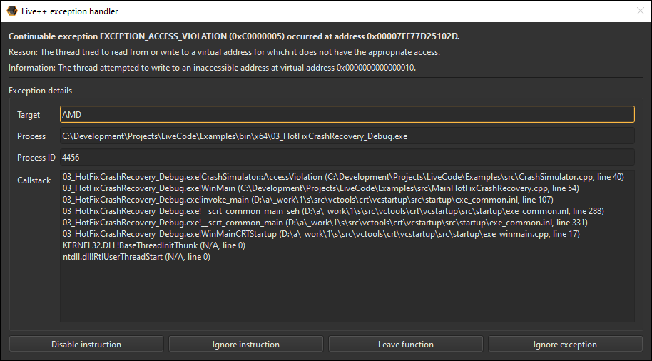
HOT-FIX
Fatal application errors
  Division by zero, access violation, etc.
Recover on-the-fly
  Make changes, hot-reload
  Disable/ignore instruction
  Leave function
  Ignore exception
Supports stack unwinding
Live demo!

Slide 15
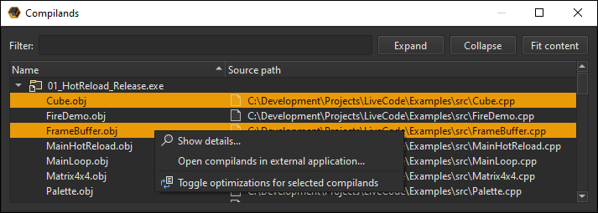
HOT-DEOPTIMIZE
Debug builds often too slow on AAA projects
Optimized builds used during development
  Lack debug information, functions are inlined
Deoptimize code on-the-fly instead
  Deoptimize
  Debug and make changes
  Hot-reload
  Return to optimized state
  Live demo!

Slide 16
Features

Slide 17
FEATURES: HOOKS
Pre- & post-compile hooks
Compile start/success/error hooks
Link start/success/error hooks
  Allow for deeper integration into engine or game
Pre- & post-patch hooks
  Serialization for supporting memory layout changes
Live demo!

Slide 18
FEATURES: UNITY SPLITTING
Projects often use unity files/buckets to combat compile times
  Compile times improve by reducing redundancy (#includes, templates)
  Great boon for full builds
  Hurt your iterative/incremental builds
Live++ can split unity buckets on-the-fly
  First hot-reload splits into individual translation units
  Subsequent hot-reloads compile single translation units only
Live demo!

Slide 19
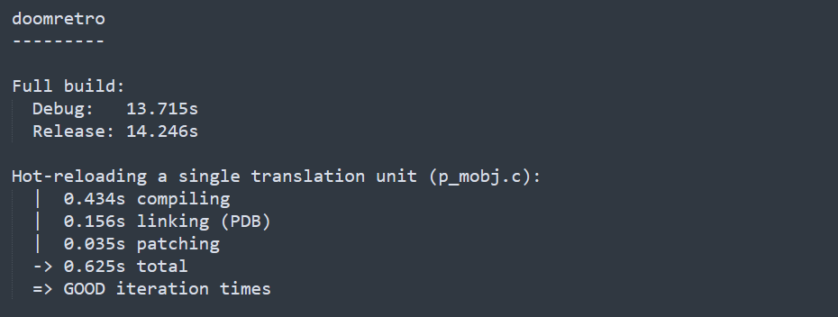
FEATURES: UNITY SPLITTING

Slide 20
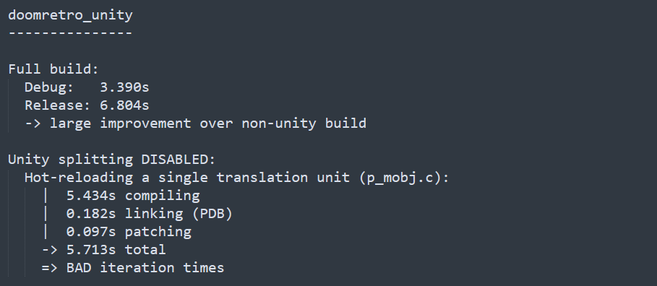
FEATURES: UNITY SPLITTING

Slide 21
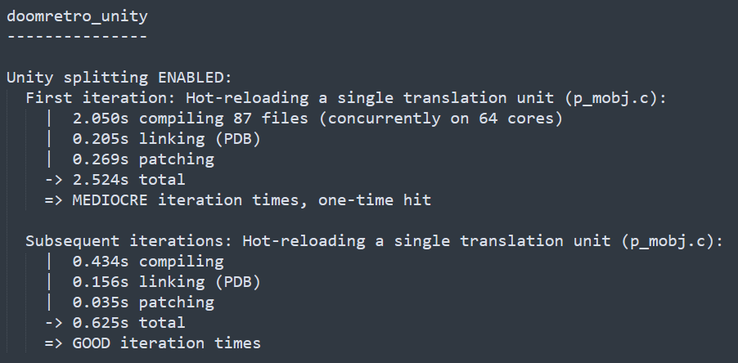
FEATURES: UNITY SPLITTING

Slide 22
FEATURES: DEDICATED SUPPORT FOR VISUAL STUDIO AND RIDER
Double-click on warning/error in Live++ Broker UI: Go to file & line
Debugger automation when hot-reloading while process is halted
Debugger automation when hot-restarting a process
Shortcut for toggling optimizations of the currently open file in the IDE
All of these work from out-of-process, no extension required
  Visual Studio: uses EnvDTE
  Rider: uses an internal protocol built in collaboration with JetBrains

Slide 23
Roadmap

Slide 24
ROADMAP
2026
  Support for Linux
  Support for Switch 2 (?)
2026/2027
  Several ideas for Live++ 3.0
    Hot-Redirect/Hot-Detour
  Working on something entirely new that perfectly complements Live++

Slide 25
THANK
YOU!
Mastodon
@molecularmusing@mastodon.gamedev.place
@liveplusplus@mastodon.gamedev.place
Bluesky
@molecularmusing.bsky.social
@liveplusplus.bsky.social
X (Twitter)
@molecularmusing
@liveplusplus
https://molecular-matters.com

