Slide 1



Live++:
A Bag of Tricks
Guerrilla Games
April 10th, 2026
Stefan Reinalter, MSc – Founder/CTO @ Molecular Matters GmbH
https://liveplusplus.tech

Slide 2
Introduction
Stefan Reinalter
  Founder/CTO/wearer of many hats @ Molecular Matters
Started in the games industry in 2003 during original Xbox/PS2 era
  1989: First programming steps on C64, Logo, BASIC
  1995: Moved to MS-DOS, Pascal, 3d programming, x86 assembler
  1999: Moved to Windows, Delphi, DirectX programming
  2002: Started studying at Vienna University of Technology, finished in 2010
Officially founded Molecular Matters in 2012
  Worked on my own engine and a real-time radiosity solution
  Freelance work (Ubisoft, Hitman PS3/Xbox360, undisclosed XB1 project)
  Started teaching, blogging, writing for AltDevBlogADay
  Contributed to Game Engine Gems 3
  Launched Live++ in March 2018

Slide 3
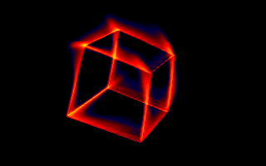



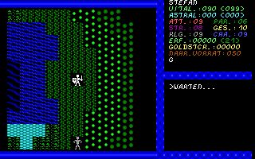
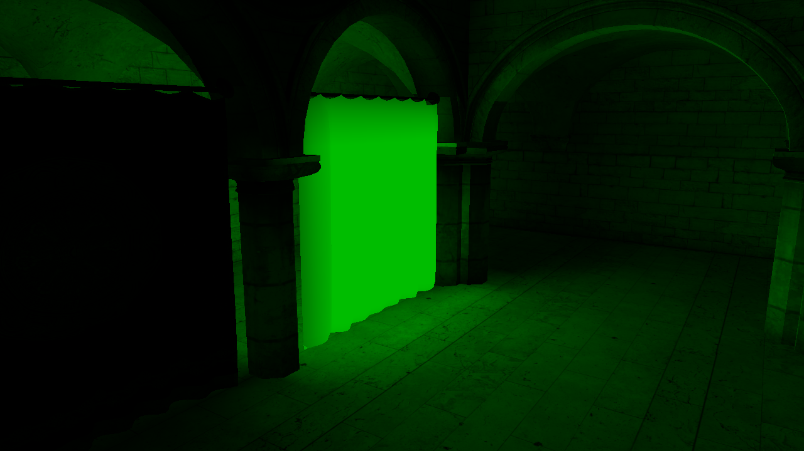
Introduction

Slide 4
Technical

Slide 5
Scoped resources
Let’s start with something easy
RAII (Resource Acquisition Is Initialization)
  Conceptually nice
  Maps well to C++ using constructors & destructors
  Useful for code with many return paths
    Especially for locking/blocking resources such as synchronization primitives
  (A bogus name for what it actually does...)

Slide 6
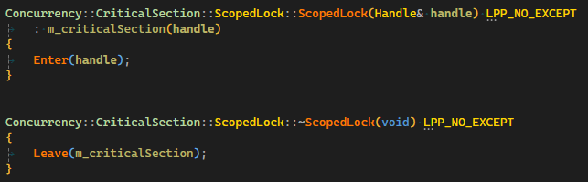
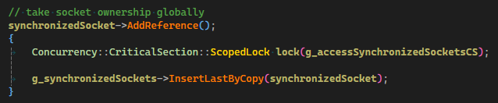
Scoped resources: RAII example

Slide 7
Scoped resources
While RAII is nice, it also:
  Is tedious to write small classes for every object
  Leads to lots of boilerplate
Would be nice to decouple “resource acquisition” from “resource cleanup”
Solution: Defer
  Proposal for next C standard
  Not available in C++, but other languages (Go, Zig)
  Let’s craft our own minimal-overhead version

Slide 8
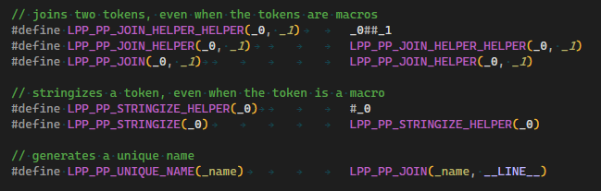
Defer: preprocessor helpers

Slide 9
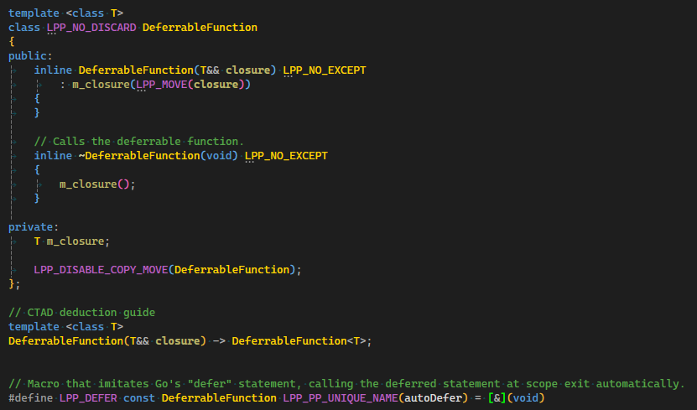
Defer: implementation (C++17)

Slide 10
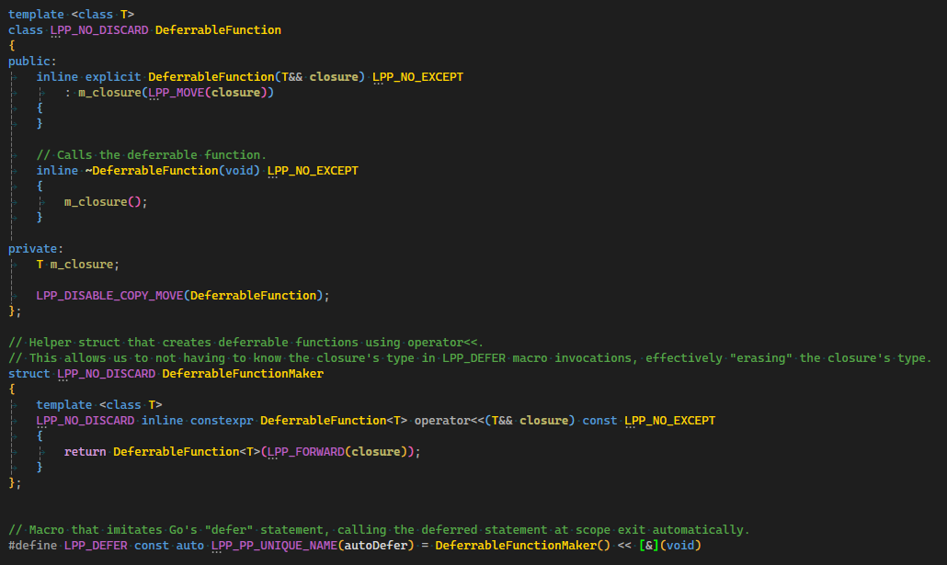
Defer: slighty different implementation (C++11)

Slide 11
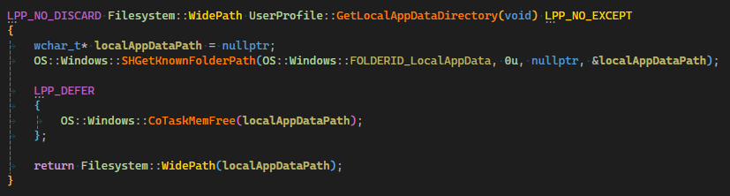
Defer: usage
Can be nicely mixed with C-like code, e.g. Win32 API
Especially when returning RVO-ed objects from C-like data:

Slide 12
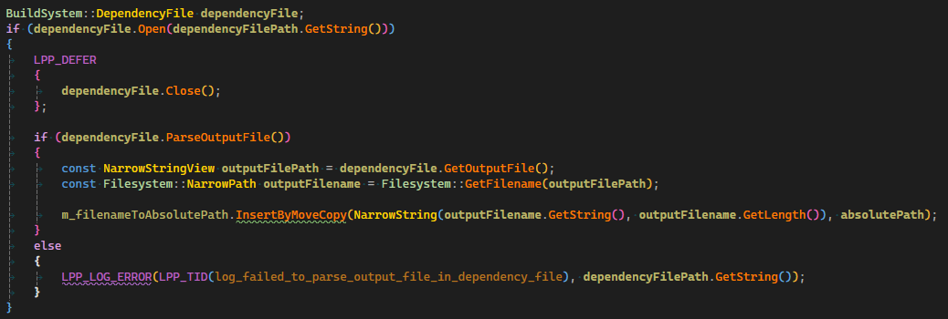
Defer: usage
Turns RAII into:
  if (Acquire())
    Defer { Cleanup(); }

Slide 13
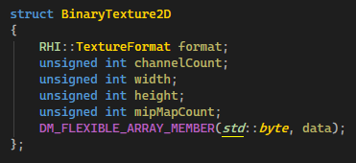
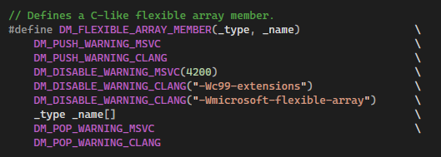
Self-relative data structures: what?
A data structure with one or more members which are relative to:
  The base of the data structure
    Often seen in file formats: every offset is relative to start of the file
    Flexible array member in C (and in C++, but not standardized)
  The address of the member itself

Slide 14
Self-relative data structures: why?
Advantages:
  Dynamically sized, but require only a single allocation
  Trivially relocatable
    memcpy
  Trivially serializable
    memcpy
Disadvantages:
  Often require pointer fix-ups
    E.g. convert offsets in file format to pointers to actual data structure
Can we have the advantages without requiring any pointer fix-up?
  Yes!
    By using this-relative pointers

Slide 15
Self-relative data structures: how?
This-relative pointer
  A relative pointer, relative to itself
  Offset is calculated based on its own location in memory

Slide 16
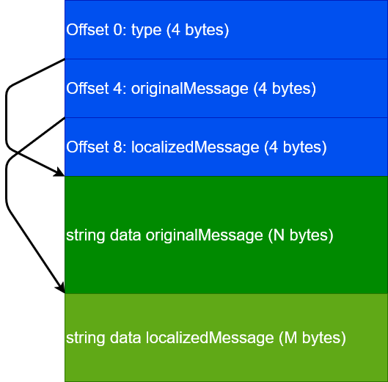
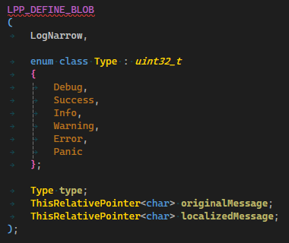
Self-relative data structures: how?
Memory layout

Slide 17
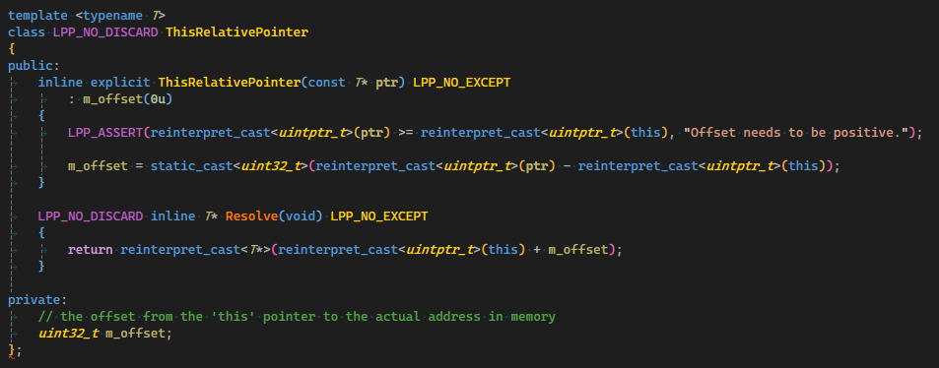
Self-relative data structures: how?
This-relative pointer
  A relative pointer, relative to itself
  Offset is calculated based on its own location in memory
  Resolve() is remarkably simple: mov from memory, followed by add

Slide 18
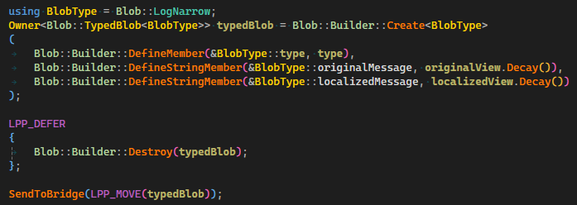
Self-relative data structures
Used for all network blobs in Live++
Building blobs is performed by a variadic helper template
  Blob::Builder::Create<T>
    Calculates total size of blob
    Initializes blob members one by one using fold expressions

Slide 19
String interning: why?
In Live++, we need to:
  Store millions of (very long) strings
    Paths
    C++ symbol names
  Compare millions of (very long) strings
    “Does symbol N in the patch already exist in the original executable?”
    Large performance overhead in Live++ 1.x.x
There is no upper limit to the number of strings
  Indie title vs. Fortnite
There is no upper limit to how many processes and executables/modules are registered with Live++
  Processes are likely to share paths
  Modules are likely to share paths and symbol names

Slide 20
String interning: how?
Important observation #1:
  The internal databases for a process can only grow
  Nothing ever gets deleted
    Original executable has N symbols
    Patch has much fewer symbols...
    ...but every future patch can refer to any of the N symbols
Important observation #2:
  Databases are “initialize once, lookup & compare often”
  Initialization performed during PDB loading
  Lookup & compare performed for each symbol in every patch
Basic idea:
  Make lookup & compare as fast as possible, O(1)
  Make initialization as fast as possible given our constraints

Slide 21
String interning: how?
A hash map <name, symbol> is an obvious choice for symbol lookup
  Resolving collisions requires (potentially expensive) symbol name comparison
  Interned strings can give us O(1) comparison
String interning requires us to identify unique strings
  Which in turn requires a hash set
Basic steps of Intern(string) operation:
  Ask hash set: does the pool of interned strings already contain string?
    Yes: nothing to store
      Return a value that uniquely identifies the existing interned string
    No: allocate space in the pool for storing the interned string
      Return a value that uniquely identifies the newly interned string

Slide 22
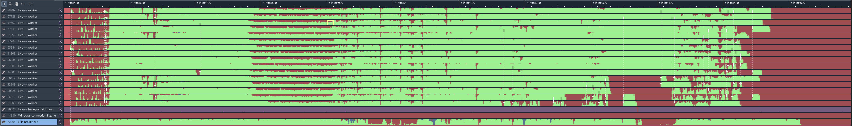
String interning: difficulties
Live++ is heavily threaded, especially initial loading
String interning has at least two choke points
  Hash set lookup and insertion for checking uniqueness of strings
    Insertion needs to lock the container
    Major source of contention
  Memory allocation for storing interned strings
    Generic allocator another source of contention

Slide 23
String interning: resolving hash set contention
Hash set checking for uniqueness can be sharded
  Remember:
    Same strings == same hashes
    Different strings == probably different hashes, but could be the same (collision)
Sharding doesn’t break what we are testing for
Use N hash sets instead of a single global hash set
  As long as different threads ask different sets, there is no contention
  Determine shard index based on string hash
    The hash is required for lookup and insertion anyway, so no additional overhead
  Careful!
    How are your hashes calculated?
    How does your hash container work internally?
      E.g. Swiss Tables use the lowest 7 bits of the hash for metadata, so do not use the hash’s LSB as shard index

Slide 24
String interning: resolving allocation contention
Start with the fastest allocator possible: a bump/linear allocator
  Trivial to implement lock-free using atomic operations
Do not know amount of required memory a priori...
...but can probably define a reasonable upper bound?
Idea:
  Reserve upper bound of address space for the whole string pool
  Grow committed memory in N pages on demand
  Use 4GiB (2³²) as upper bound
    Each interned string lives somewhere in this 4GiB range
    Each interned string is uniquely identified by a 4-byte offset
    Testing two interned strings for equality becomes a single 4-byte comparison
  Reminder: we would need >4GiB of unique strings to break this limit

Slide 25
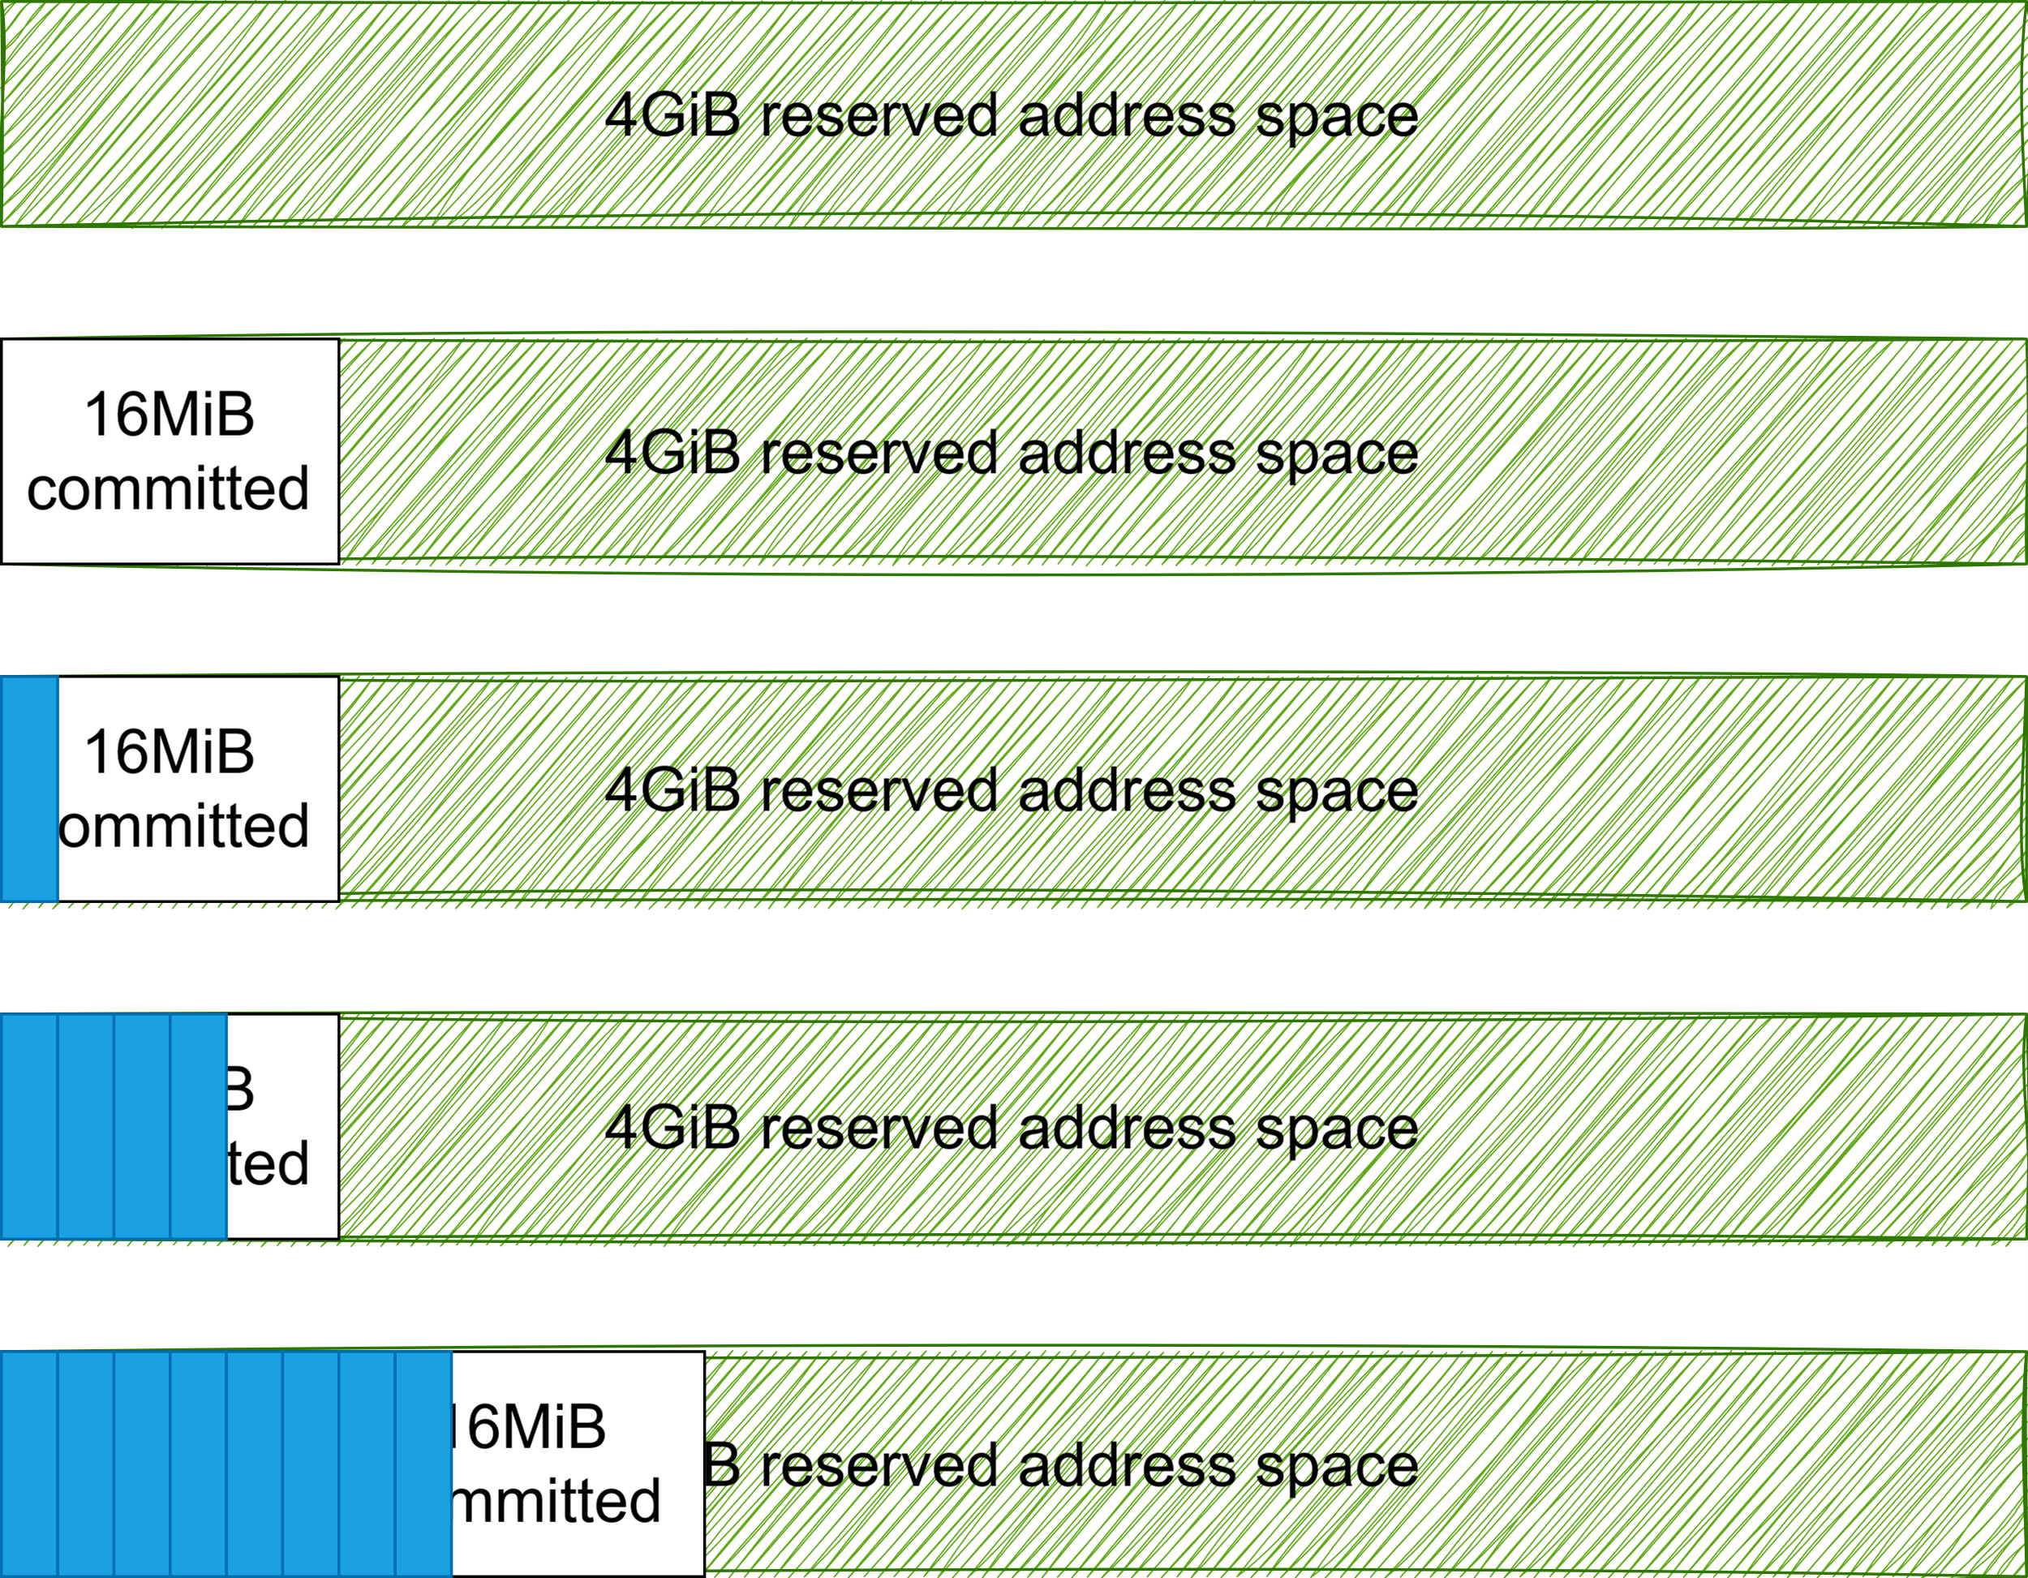
String interning: resolving allocation contention

Slide 26
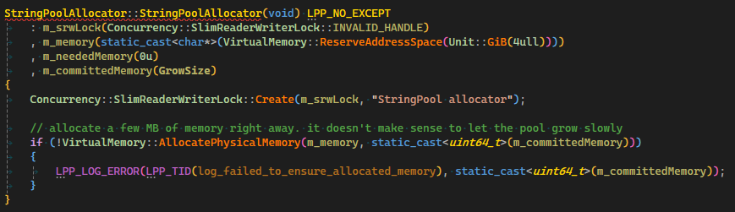
String interning: resolving allocation contention
Implemented using Windows’ virtual memory API
  VirtualAlloc(MEM_RESERVE) for reservation
  VirtualAlloc(MEM_COMMIT) for committing pages
Bump allocator is basically lock-free except when committing new pages
Initialization:

Slide 27
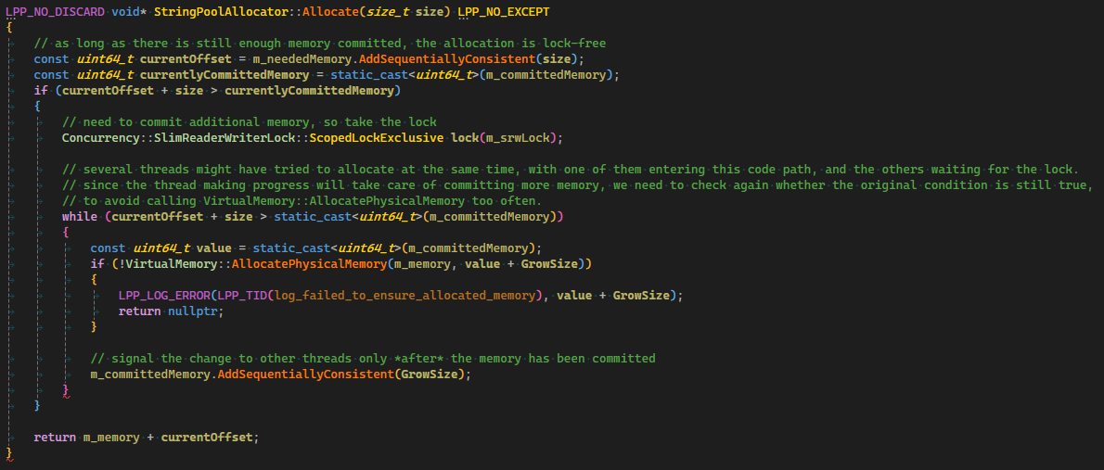
String interning: resolving allocation contention
Allocation:

Slide 28
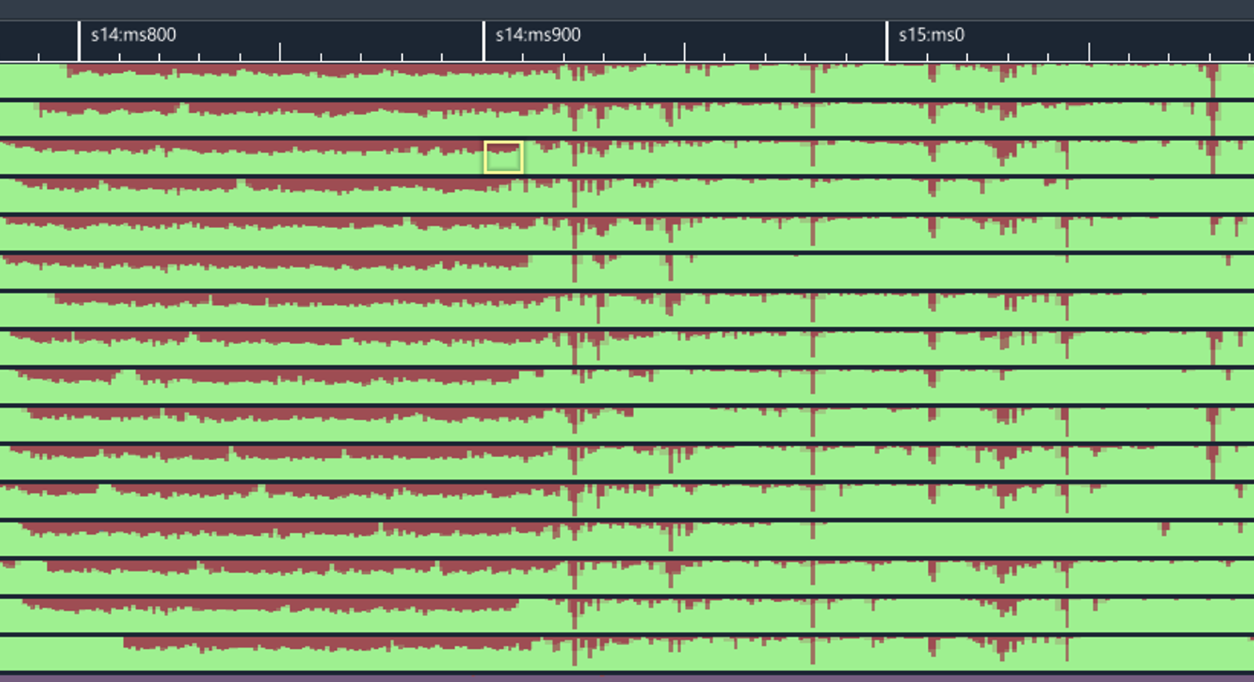
String interning
Live++ uses:
  256 hash set shards
    Each shard has its own slim reader-writer lock
    Hash set optimized for insertion & lookup, does not support deletion
  Bump allocator
  GrowSize of 16 MiB

Slide 29
Non-technical

Slide 30
How I (try to) work
Mostly work on difficult technical problems these days
  Both Live++ and my Next Thing
Used to really get my teeth into these problems
  Returning to the office after dinner with friends, staying until 4am
  Working 80+ hours per week for years
I am no longer in a position to work even 8 hours a day
Need to make the best of my time
What to do?

Slide 31
How I (try to) work
Our brains are wonderful problem solvers
Let the brain do its thing on a background thread
  You probably know these “had an idea under the shower” moments
There is research behind this, called “Incubation effect”
Pre-incubation: initial attempt at solving a problem, but you get stuck
Incubation: taking a break from the problem
Post-incubation: returning to the problem with a “fresh pair of eyes”
But also:
  Having an epiphany under the shower
  Having an idea for solving a difficult problem at dinner
  “My background thread just called” has become a thing in our household

Slide 32
How I no longer work
Trying to solve a tremendously difficult problem over a span of several hours or even days
  Come prepared, having done my research about the topic at hand
  Having an initial idea, trying that
    Failing
  Having another idea, trying that
    Failing again
  ...
  More relentless hacking and trying
  Not giving up
  Not taking a break
  “I need to solve this today!”

Slide 33
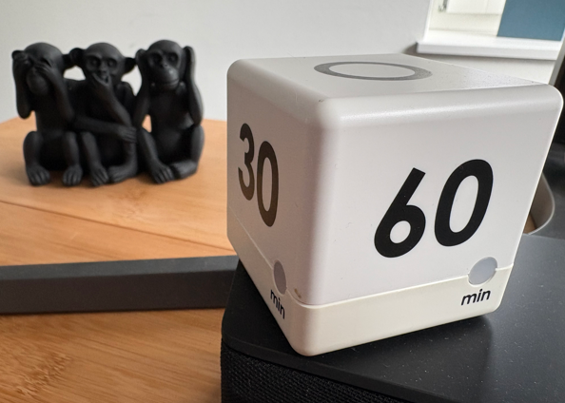
How I work nowadays instead
Trying to solve a tremendously difficult problem over a span of several hours or even days
  Come prepared, having done my research about the topic at hand
  Having an initial idea, trying that
    Failing
  Having another idea, trying that
    Failing again
  Realizing “I won’t solve this today”
  Going for a walk, going for a run
  Playing with my cats
  Scribbling ideas using pen and paper
  Working on something entirely different
    Even a completely different project
  Working in focused one-hour bursts

Slide 34
Final thoughts
Disclaimer: probably doesn’t apply to everybody
  Being an employee is a different setting than running a business
Still, I strongly urge you to give it a try the next time you’re stuck
  If you can, switch to an easy task in a completely different part of the codebase
  If you can, switch to a completely different project
  Get out, enjoy a walk
    This is not procrastinating, you’re still working – your brain is doing the work subconsciously
  All of these reduce mental fixation on a single particular problem
It takes getting used to
  But I truly believe this is a learnable skill

Slide 35
THANK
YOU!
X (Twitter)
@molecularmusing
@liveplusplus
Bluesky
@molecularmusing.bsky.social
@liveplusplus.bsky.social
Mastodon
@molecularmusing@mastodon.gamedev.place
@liveplusplus@mastodon.gamedev.place

Slide 36
Bonus Technical

Slide 37
Canonical paths and file attributes: why?
Paths are a mess
  PDBs use a mix of absolute paths, relative paths, mixed-case paths, lower-case paths, ...
  “D:\Folder\A\..\file.bin”
  “D:\Folder\A\B\..\..\file.bin”
  “D:\folder\FILE.bin”
  “E:\reparsePoint\file.BIN”
They all point to the same path underneath
  Redundant strings in our pool
  The bigger problem: symbol lookup
    Names for certain symbols with internal linkage are suffixed
    Conceptually, suffix is path of the object file, e.g. “@mySymbol%D:\folder\file.obj”
    Actually stored with offset of the interned string, e.g. “@mySymbol%01234567”

Slide 38
Canonical paths and file attributes: why?
Live++ needs canonical paths for:
  Source files
  Object files
  EXE/DLL/PDB files (on Xbox)
Live++ has to perform potentially hundreds of thousands “Does this file exist?” tests during initialization for finding .cpp, .obj and .lib
  There are no rules for how toolchains should store paths inside the PDB
  Absolute paths? Those are usually fine
  Relative paths? Need to try different combinations of:
    Compiler/linker working directory
    Relative to EXE/PDB
    Static libraries?
    Compiled translation unit vs. linked translation unit

Slide 39
Canonical paths and file attributes: how?
Live++ also needs the creation time and modification time
  File existence tests can be handled via timestamps
Good news: there are Win32 APIs
  GetFileAttributesEx
    No handle required
  GetFinalPathNameByHandle
    As the name implies, requires a file handle
Bad news: the Windows filesystem is notoriously slow
  For AAA projects, these API calls add up
Important observation:
  We have a number of files F stored in a number of directories D
  On average, #D is much smaller than #F

Slide 40
Canonical paths and file attributes
Spelunking around at http://undocumented.ntinternals.net/index.html
  NtQueryDirectoryFile
    Requires a directory handle
    Returns 64KiB worth of FILE_DIRECTORY_INFORMATION data
      Case-correct filenames
      Timestamps
Feed two birds with one scone!
Strategy employed by Live++ during initialization:
  Gather unique directories from all PDB paths via hash set
  Prime an AttributeCache with all unique directories
    GetFinalPathNameByHandle used on directory path
    NtQueryDirectoryFile used for directory files
  Consult AttributeCache instead of Windows filesystem

Slide 41
Sidenote: Windows API regressions
There have been several API performance regressions over the years
Live++ now uses all of these:
  NtReadVirtualMemory
  NtWriteVirtualMemory
  NtQuerySystemInformation
  NtQueryInformationProcess
  NtQueryVirtualMemory
  NtQueryDirectoryFile
  NtQueryInformationFile
And also these, but for other reasons:
  NtSuspendProcess
  NtResumeProcess
  NtContinue

